Slide 1

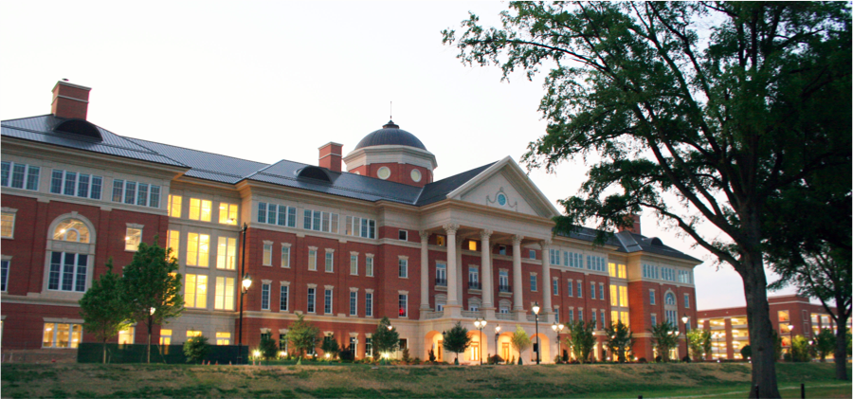
A Brief Introduction to Bioinformatics in Human Genetics
Xinghua Mindy Shi
x.shi@uncc.edu
http://shilab.uncc.edu
Department of Bioinformatics and Genomics
University of North Carolina at Charlotte
March 21, 2015

Slide 2
Outline
A Brief Introduction to Bioinformatics and Human Genetics
Joint Effect of Genetic Variants on Phenotypes
A Network Approach for Integrative Analysis of Genomic Data
Genetic Privacy
Summary and future work

Slide 3
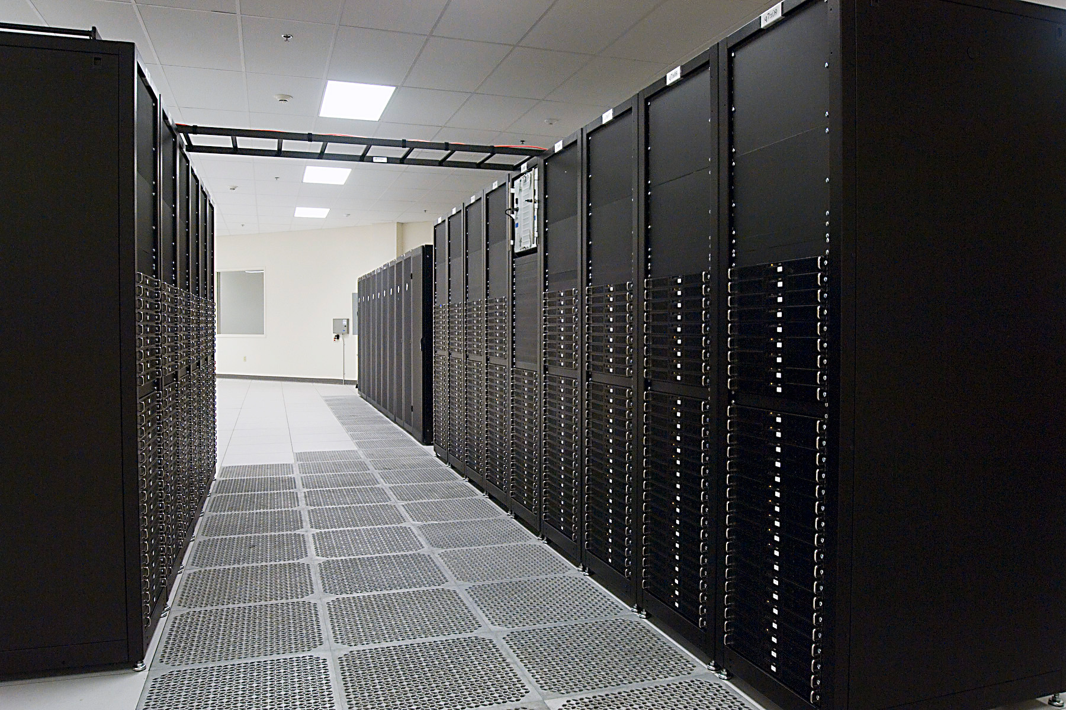
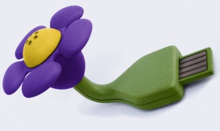
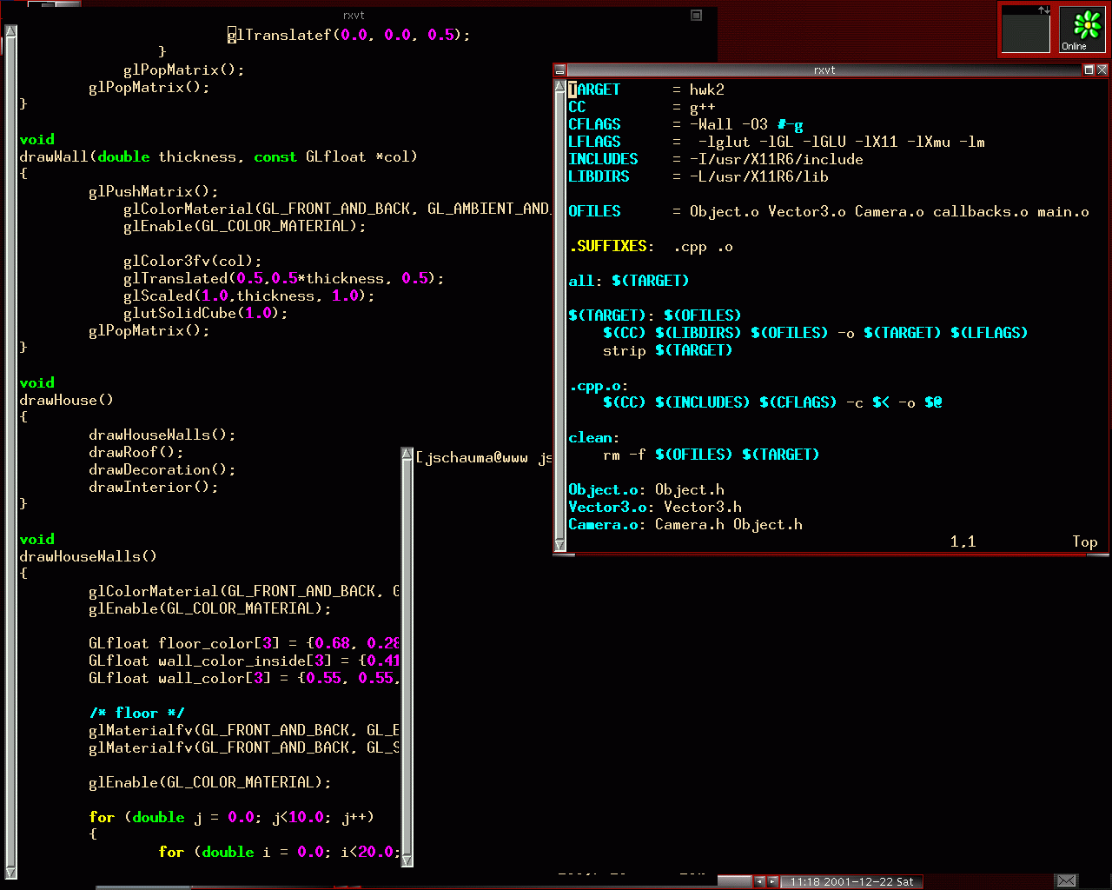
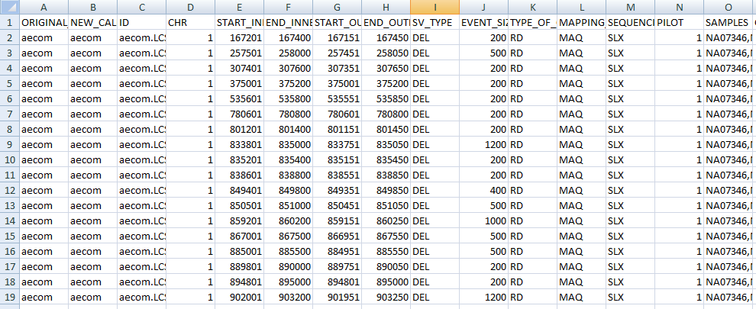
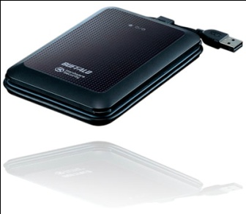
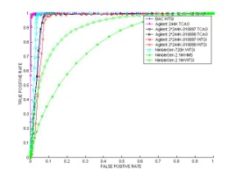
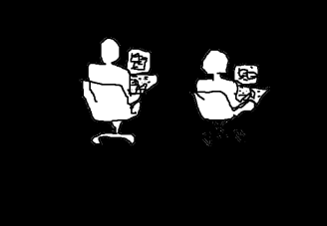
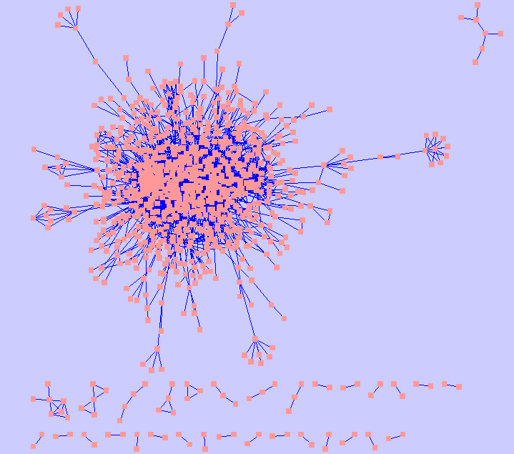
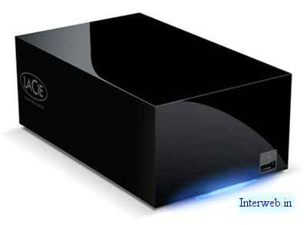
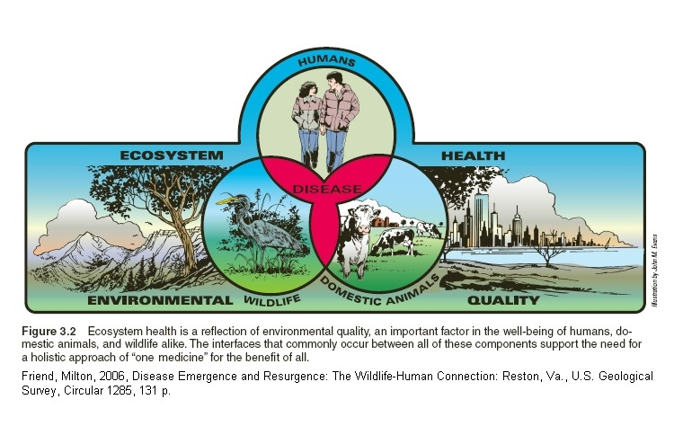

Bioinformatics
DATA
BLACKBOX
RESULTS
Human Genetics

Slide 4
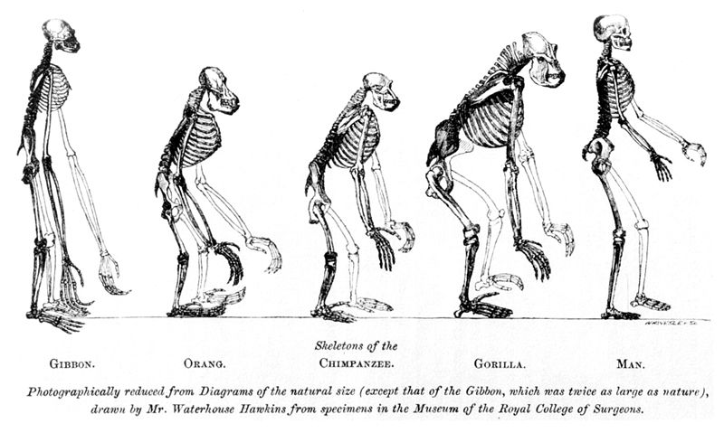
Human’s Place in Nature

Slide 5
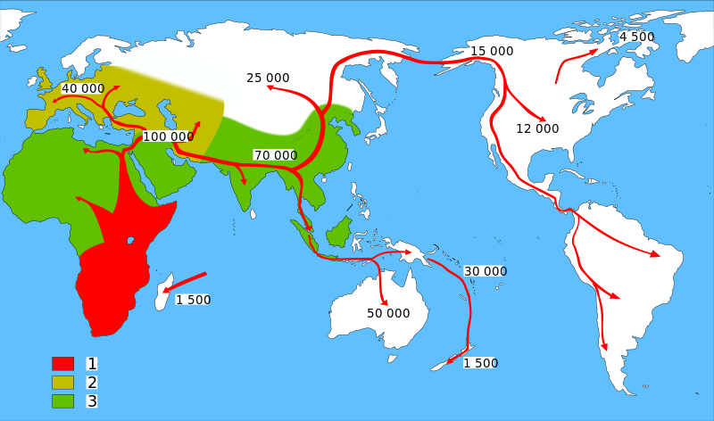
Map of early human Migrations “Out-of-Africa”
Homo sapiens (model humans)
Neanderthals (extinct human)
Early Hominids (early humans)
http://en.wikipedia.org/wiki/Recent_African_origin_of_modern_humans
Notes:
Genetic studies and fossil evidence show that archaic Homo sapiens evolved to anatomically modern humans solely in Africa between 200,000 and 60,000 years ago,^{[1]} that members of one branch of Homo sapiens left Africa at some point between 125,000 and 60,000 years ago, and that over time these humans replaced more primitive populations of the genus Homo such as Neanderthals and Homo erectus

Slide 6
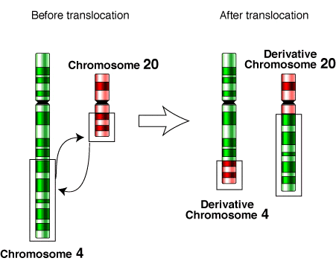
Genetic Variants
Ref.
A
Sample
C
Single Nucleotide Polymorphisms (SNPs, over a hundred million, ~0.1% genetic difference)
1bp
Small Insertions and Deletions (INDELs, tens of millions, ~0.2-0.3%)
Multiple base pairs (1bp ~ 50bp, arbitrary)
Structural Variants (SVs, ~100 thousand, ~0.6-0.7% genetic difference)
A large number of base pairs (50bp+, arbitrary)
Encompasses:
Copy number variants (CNVs: Deletions, Duplications, Insertions)
Balanced events (Inversions, Translocations)
Ref.
A
Sample
TCA
Deletion
Duplication
Insertion
Inversion
Ref.
Ref.
Ref.
Ref.
Sample
Sample
Sample
Sample
Notes:
Now let’s look at different types of genetic variants in our genomes.
The most well studied category of genetic variants include SNPs. It is estimated that there would be over a hundred million SNPs in human genome. These SNPs make up around 0.1% genetic difference between any two of us.
The second category of genetic variants is composed of indels.
Another category of include large SVs. From 50bp to mega base pairs. they can also reach to the whole chromosome.
SVs encompass several forms, from copy number variants including, to balnaced events.
Switch of direction of DNA segement and translocations that involve in the exchange of DNA content between two different chromosomes.
It is estimated that there are over a hundred thousand of SVs. Although we have fewer SVs in our genomes comparing to SNPs. Due to their large sizes, they contribute to 6 to 7 fold of genetic diff than SNPs.
I’ll touch on SNPs and INDELs, however, in this talk I’ll focus on SVs that our lab has been pioneered in.
Focus on SVs, particularly CNVs (large deletions)
Mosaism
Why do we care about these SVs?

Slide 7
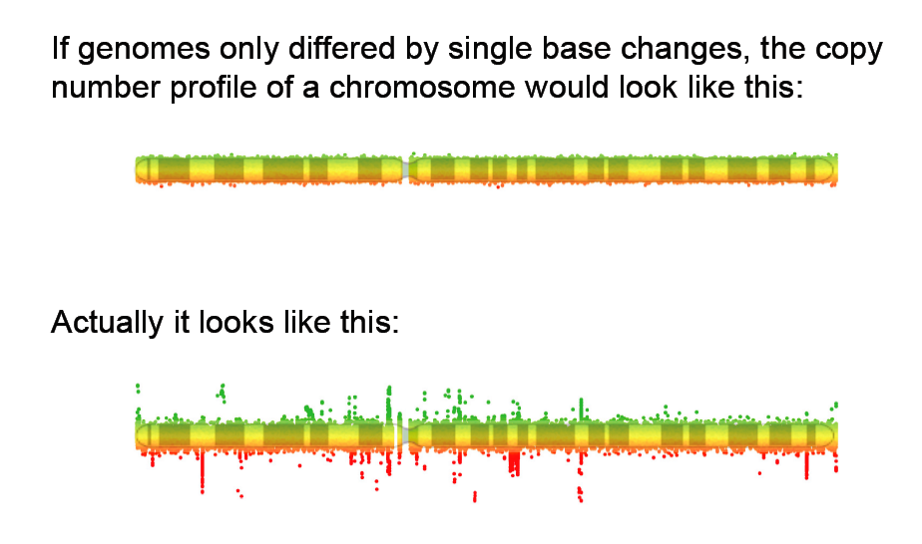
Based on SNPs, the difference between the genomes of two humans was thought to be 0.1%
Integrating SVs, this number goes up to 0.8% with ~3.5% of the Reference Genome Variable.
Slide in courtesy of Omer Gokcumen

Slide 8

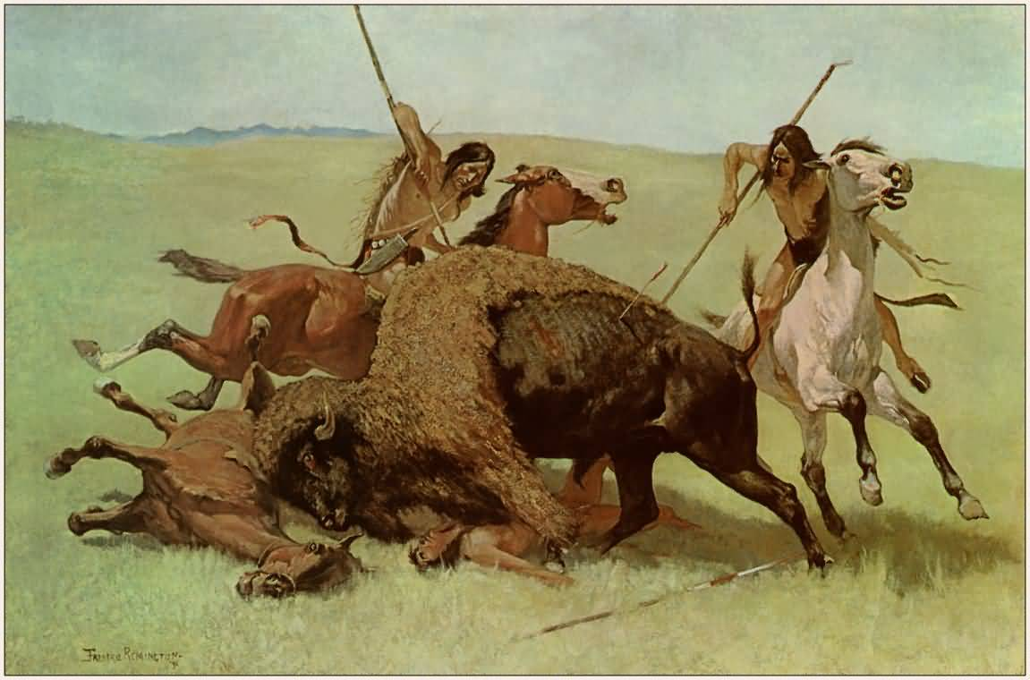
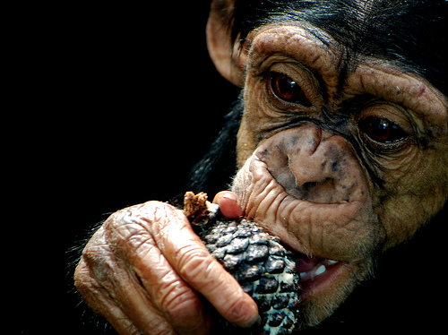
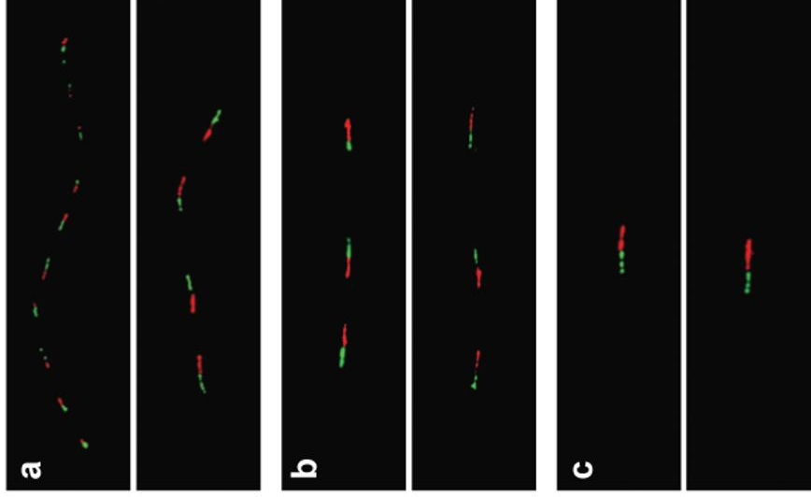

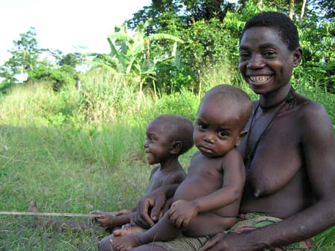
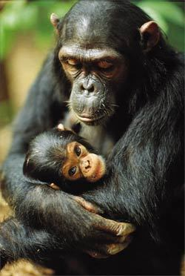
Salivary amylase gene
Salivary amylase gene Amy1: More copy numbers in populations with high-starch diets.
Japanese
Biaka (Africa)
Chimpanzee
Perry GH et al. Nature Genetics 2007
Notes:
Two studies in 2004, including one from my lab, laid the foundations of studying SVs in human population.
A follow up study in my lab in 2007, presented the first example of positive selection on a copy number-variable gene Amy1. Individuals with high-starch diets tend to have a higher copy number of the salivary amylase gene Amy1 (which helps with starch digestion), compared to those populations with low-starch diets.
fiber FISH validation of AMY1 copy number estimates.
Red (10 kb) and green (8 kb) probes encompass the entire AMY1 gene and a retrotransposon directly upstream of (and unique to) AMY1, respectively. (a) Japanese individual GM18972 was estimated by qPCR to have 14 (13.73 0.93) diploid AMY1 gene copies, consistent with fiber FISH results showing one allele with ten copies and the other with four copies. (b) Biaka individual GM10472 was estimated by qPCR to have six (6.11 0.17) diploid AMY1 gene copies, consistent with fiber FISH results. (c) The reference chimpanzee (Clint; S006006) was confirmed to have two diploid AMY1 gene copies.
hunter-gatherer lifestyle

Slide 9
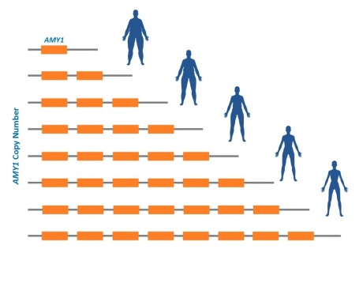
AMY1 and Obesity
Individuals with more copies of AMY1 were at lower risk of obesity.
The chance of being obese for people with <4 copies of the AMY1 gene was approximately 8 times higher than in those with more than 9 copies of this gene.
The researchers estimated that with every additional copy of the salivary amylase gene there was approximately a 20% decrease in the odds of becoming obese.
Falchi M et al. Nature Genetics 2014
Notes:
Researchers from Imperial College London, in collaboration with other international institutions, looked at the number of copies of the gene AMY1 present in the DNA of thousands of people from the UK, France, Sweden and Singapore. They found that people who carried a low number of copies of the salivary amylase gene were at greater risk of obesity.

Slide 10
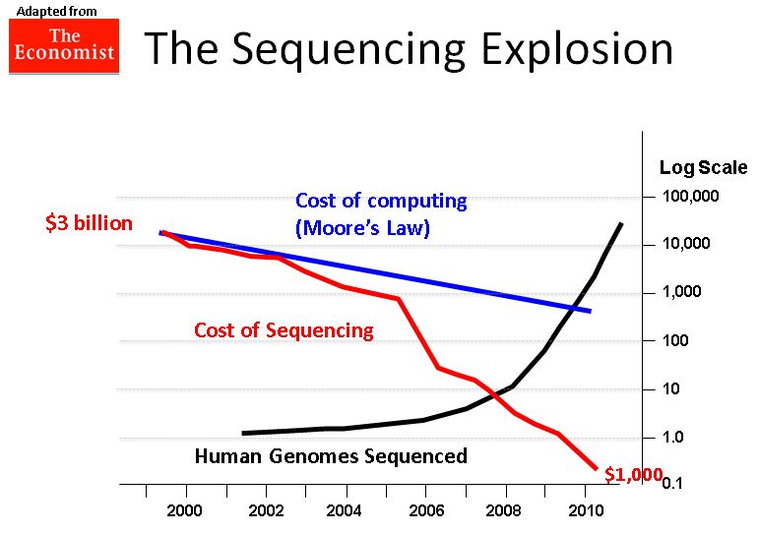

Slide 11
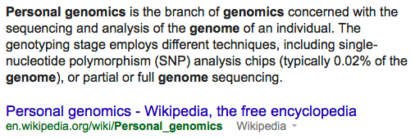
Personal Genomics

Slide 12
Big Data Era for Genetics
The 1000 Genomes project has sequenced 2,504 individuals in total.
As of March 2013 our ftp site is 464 terabytes and continuing to grow.
Can store ~145,000,000 MP3 songs.

Slide 13
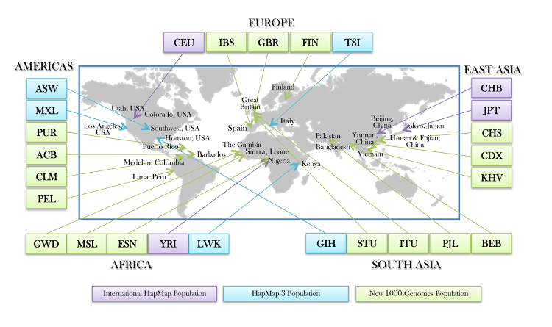
The 1000 Genomes Project
26 populations, 2504 individuals.
1000 Genomes Project Consortium.
Notes:
A – Total number of samples sequenced; B – Source of DNA (blood (bld) or LCL); C – Gender composition (Male/Female); D – Number that are part of mother-father-child trios (t), parent-child duos (d) or singletons (s).

Slide 14
Clinical Sequencing – Federal Initiatives
Million Genome Project from Obama’s Precision Medicine Initiative, 2015.
Genomes England Project (the 100,000 Genomes Project) 2014, UK 10K Project.
Million Veterans Project US, already collected DNA samples from 343,000 former soldiers 2015.
International Cancer Genome Consortium (ICCG) and The Cancer Genome Atlas (TCGA) projects chart the genomic changes involved in more than 20 types of cancer (WGS of 5000 individuals, WES of 10,000 individuals).

Slide 15
Clinical Sequencing – Private Sections
J. Craig Venter plans to sequence one million genomes by 2020 using private funding.
One of the world’s largest private bio-banks, 23andMe, collected 800,000 spit samples.
Large disease consortia and hospitals/institutions/pharmaceutical/biotech companies conduct whole genome sequencing of clinical samples.
Notes:
Google Genomics
Facebook?

Slide 16
From Genomics to Metagenomics
Microbes thrive on us: we provide wonderfully rich and varied homes for our 100 trillion microbial (bacterial and archaeal) partners.
Human Microbiome Project
characterize microbial communities found at multiple human body sites and to look for correlations between changes in the microbiome and human health.
We are also host to countless viruses. A recent survey reported that human feces contain about a billion RNA viruses per gram, representing 42 viral “species”.
Viral Metagenomics
National Research Council (US) Committee on Metagenomics: Challenges and Functional Applications. 2007

Slide 17
Outline
A Brief Introduction to Bioinformatics and Human Genetics
Joint Effect of Genetic Variants on Phenotypes
A Network Approach for Integrative Analysis of Genomic Data
Genetic Privacy
Summary and future work

Slide 18
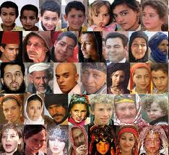
Genome Wide Association Study
The 1000 Genomes Project
Genome Wide Association Study (GWAS)
Genetic Variation
Phenotypic Variation
Sample_1
Sample_2
Sample_3
……
Sample_n-1
Sample_n
Notes:
Excited!!!
Building catalog, in the hayday of looking at these
Resource. Post-1000GP era
Now we have a list of genetic variants, let’s look at how they contribute to phenotypic variation through GWAS

Slide 19
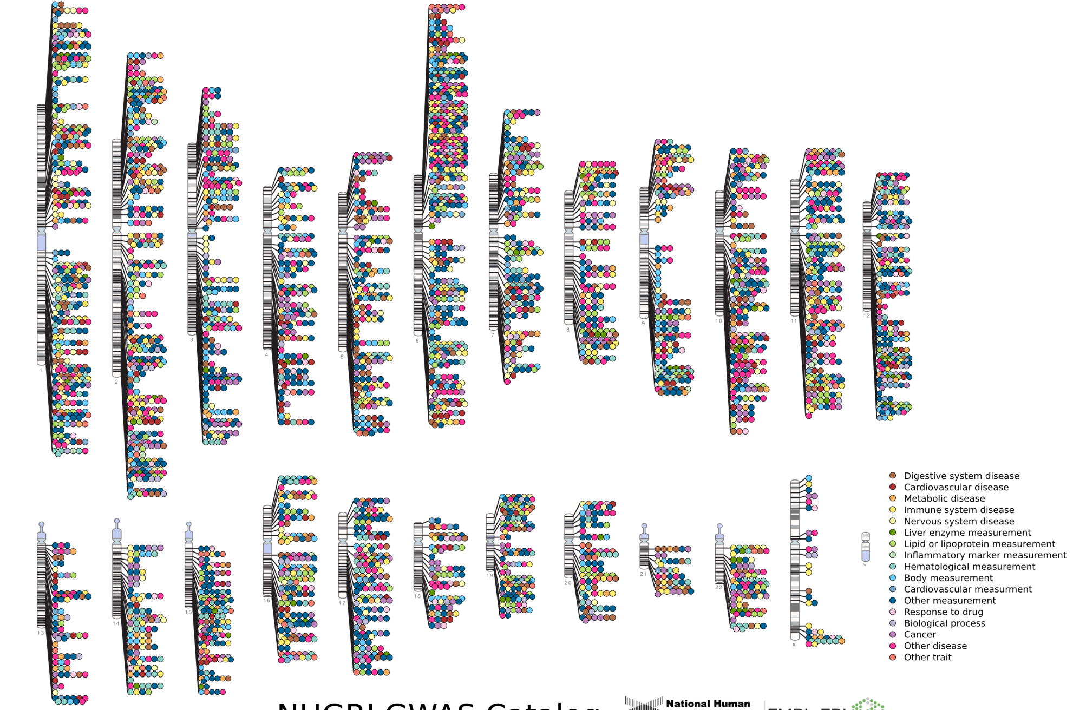

Published Genome-Wide Associations through 12/2013
Published GWA at p≤5X10⁻⁸ for 17 trait categories
NHGRI GWA Catalog
www.genome.gov/GWAStudies
www.ebi.ac.uk/fgpt/gwas/
Notes:
chromosome ideogram

Slide 20
NHGRI GWA Catalog
www.genome.gov/GWAStudies
www.ebi.ac.uk/fgpt/gwas/

Slide 21
Missing/Hidden Heritability
GWAS hits only explain a small portion of the heritability
height ~80%; 12 SNPs together ~2% (Lettre et al., Nat Genet., 2008), 180 SNPs ~10% (GIANT, Nature, 2010); 294,831 SNPs ~45% (Yang et al., Nature, 2011)
(Missing) Hidden Heritability:
Rare variants
A comprehensive list of genetic variants (SNPs, INDELs,SVs)
Joint effect of multiple variants (Epistasis/gene-gene interactions, pathways/subnetworks)
Two-hit disease model for developmental delay: (16p12.1 deletion, 14q11.2 deletion) (Girirajan et al., Nat Genet. 2010)
Gene-environment interactions and epigenetics
Notes:
Figure for height
Despite the success of GWAS of identifying SNPs associated with diesease, the major criticism/concern of GWAS is that these GWAS hits only
There is a growing evidence that even all the common variants are combined, we cannot explain all of the heritability of traits. This leads to an argument that the heritability is not missing, but hidden in other factors.
, was reported to pair with a second-hit CNV involving a 1.5Mb deletion ay chromosome locus
I am particularly interested in the joint effect of multiple variants on phenotypes. Now let’s look at how we address this problem.

Slide 22
Joint Effect of Genetic Variants
Notes:
An illustration of the scenario that multiple genetic variants (e.g. genic CNVs) overlapping with genes, in the form of a subnetwork, are jointly associated with different phenotypes. Genetic variants are treated as features and categorical phenotypes are represented as labels in the models. Each of three exemplar genic CNVs (CNV A, CNV B, CNV C) has three genotypes (CN0, CN1, CN2) and overlaps with corresponding genes (Gene A, Gene B, Gene C). The subnetwork/pathway among these genic CNVs, as shown in the dotted oval, is formed by connecting the corresponding genes with biological interactions such as protein-protein interactions extracted from a protein-protein interaction network. The feature matrix is formed by coalescing the genotype profiles of all the samples under investigation. The open squares on labels represent the phenotype class of 0 and the closed squares represent that of 1. In this example, sample 2 is associated with phenotype class 1 has the only genotype combination (CN0, CN0, CN1) for the three CNVs respectively, as marked in closed squares for the genotype profiles and highlighted in blue square in the feature matrix. The samples with all the other combinations of genotypes for the three CNVs (open squares of the genotype profiles in the features) are associated with phenotype class 0.

Slide 23
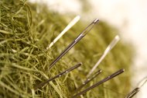
Challenges
Computational challenge
“needles in a haystack”
The inhibitive number of combinations of a large number of genetic variants: O(2^{p})
Infeasible to do an exhaustive search
Biological challenge
What combinations of variants we should prioritize?
Notes:
The changes for identifying such joint effect of multiple variants lie in two-folds.
N is a large number, tens of thousands CNVs, tens of millions of INDELs/SNPs
Imagine these needles are tied together along a string, then it’s easier to find them in a haystack

Slide 24
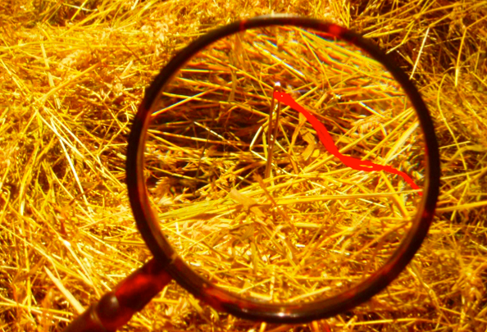
Methodology - CNVnet
Statistical/machine learning (group LASSO logistic regression model)
Sparse learning on high-dimensional data
The number of features/CNVs is significantly larger than the number of samples in the data set (n << p)
Only a small fraction of CNV combinations are associated with phenotypes
Biological networks (interactive CNVs on a functional variant network)
Needles tied along a thread (“needles in a haystack”)
Notes:
Back to the needles in the haystack analogy. Imagine these needles are distributed but there a few that are tied together along a thread. We will focus on these linked needles because they are easier to spot than dispersed ones.

Slide 25
Results: CEU vs. non-CEU
The expression of PTEN explained some population stratification between CEU and ASN (Spielman RS et al., Nat Gen, 2009).
PTEN mutation is more frequent in Caucasians relative to African Americans and is associated with favorable survival in advanced endometrial cancer (Maxwell GL et al., Clinical Cancer Research, 2000).
Notes:
The mutations of PTEN tumor suppressor gene have been reported to have population disparity in cancers:
These observations may imply that besides PTEN, the other genes in this group should be checked for their population disparity and additionally examined for their effects on outcome in these cancer types.

Slide 26
Outline
A Brief Introduction to Bioinformatics and Human Genetics
Joint Effect of Genetic Variants on Phenotypes
A Network Approach for Integrative Analysis of Genomic Data
Genetic Privacy
Summary and future work

Slide 27

MicroRNAs and Ovarian Cancer
MicroRNAs (miRNAs) are small (22 nucleotides) non-coding regulatory RNAs.
miRNAs regulate gene expression by targeting complementary mRNA for translational blockade or degradation.
Differential miRNA expression and miRNA dysregulation have been associated with cancer signatures, including ovarian cancer.
A study by The Cancer Genome Atlas (TCGA) examined mRNA transcription and miRNA expression in high grade serous ovarian cancer, and found three miRNA subtypes.

Slide 28
Questions and Approach
How does miRNA affect gene expression in ovarian cancer both locally and distally?
What’s the underlying network for such effect?
Borrowed the idea from gene expression quantitative trait loci (eQTL) mapping.
Genome-wide mapping of miRNA-gene expression quantitative trait loci (ieQTL) using the ovarian cancer data from The Cancer Genome Atlas (TCGA).
Notes:
Combinatorial regulation is a feature of miRNA regulation. A given miRNA may have multiple different mRNA targets, and a given target might similarly be targeted by multiple miRNAs.

Slide 29
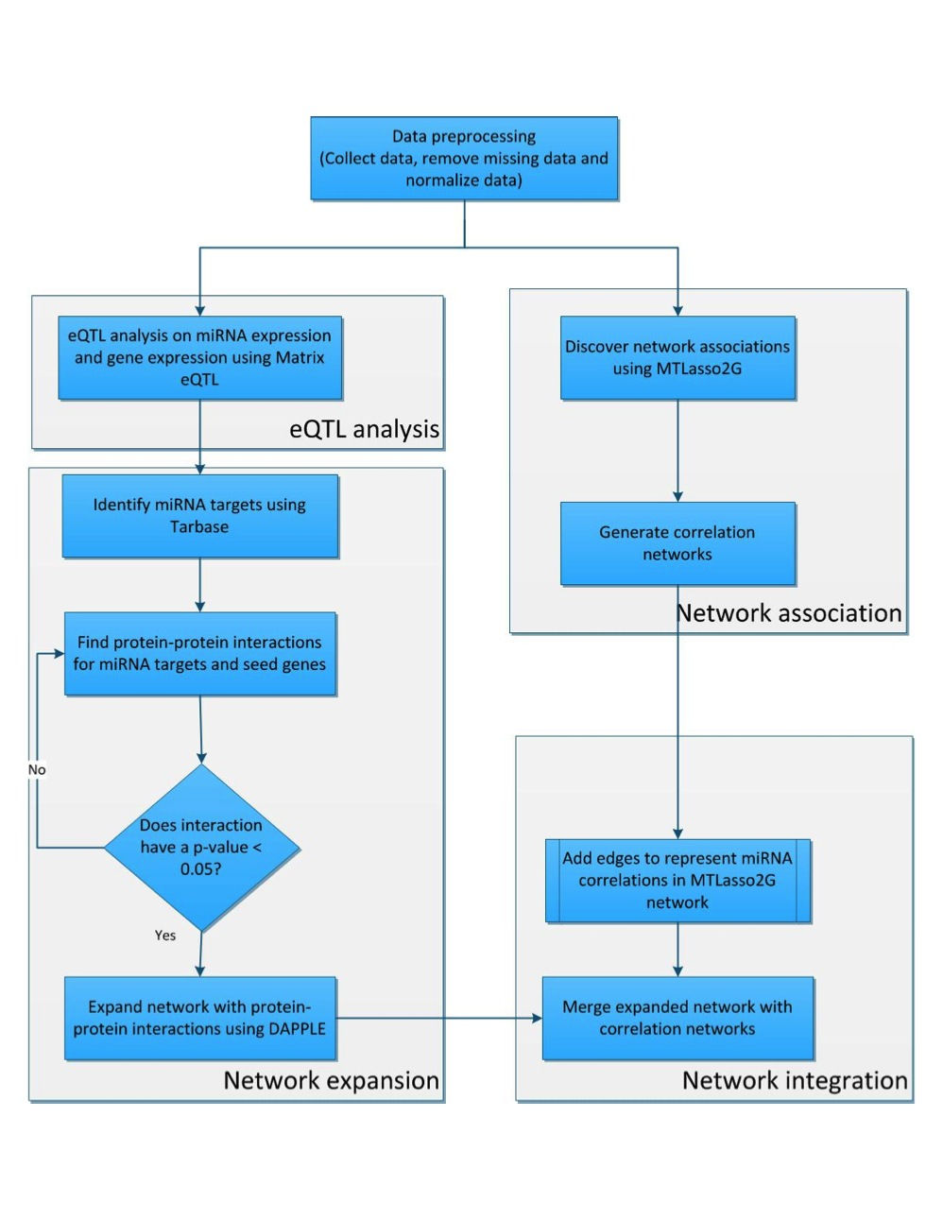

Slide 30
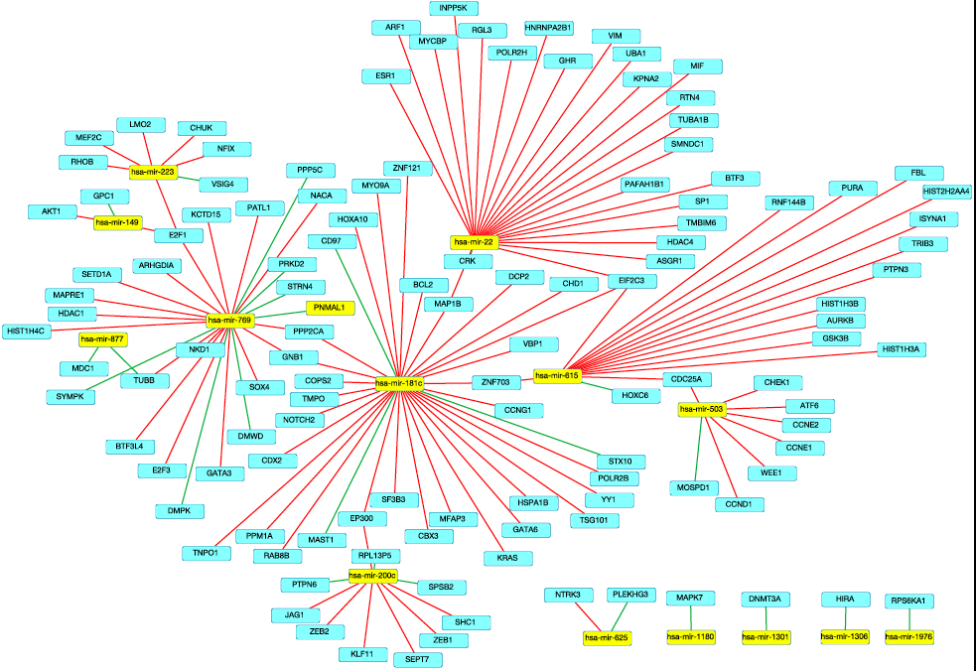

Slide 31
Multi-Omics Data Integration
Genome Wide Association Study (GWAS)
Genetic Variation
Phenotypic Variation
Sample_1
Sample_2
Gene Expression Variation
Sample_3
Methylation Variation
……
Sample_n-1
Dnase I Sensitivity Variation
Sample_n
MicroRNA Variation
mQTL
dsQTL
eQTL Mapping
miRNA eQTL

Slide 32
Outline
A Brief Introduction to Bioinformatics and Human Genetics
Joint Effect of Genetic Variants on Phenotypes
A Network Approach for Integrative Analysis of Genomic Data
Genetic Privacy
Summary and future work

Slide 33
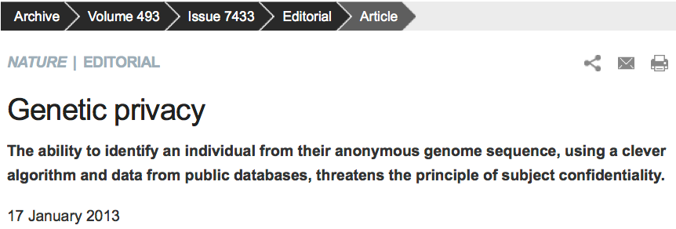
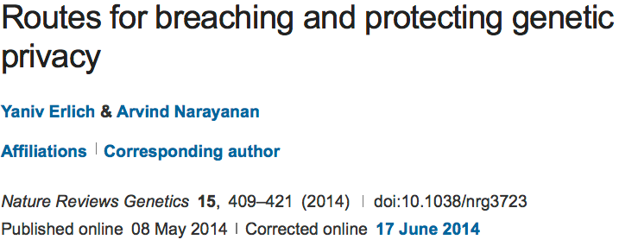
Genetic Privacy

Slide 34
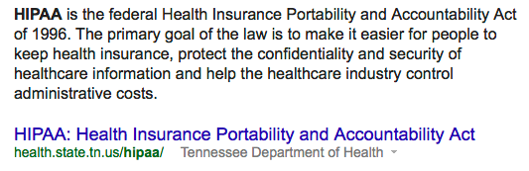
Introduction to HIPAA
Protected Health Information
The Privacy Rule protects all "individually identifiable health information"
De-Identified Health Information
There are no restrictions on the use or disclosure of de-identified health information.

Slide 35
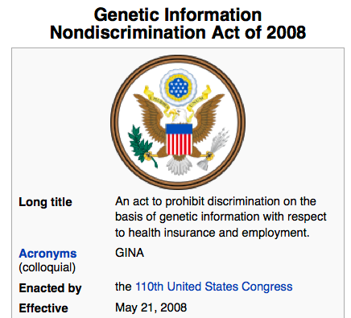
GINA

Slide 36
Genetic hiding/masking
The public release of Dr James Watson’s genome sequence was removed of all gene information about apolipoprotein E (ApoE). This decision was rooted from respecting Dr Watson’s wishes for preventing prediction of his risk for late-onset Alzheimer’s disease conveyed by APOE risk alleles.
However, the linkage disequilibrium (LD, i.e., non-random associations) between other polymorphisms and APOE can be used to predict APOE status using advanced computational methods.
Therefore, it is insufficient to hide genetic information at disease risk loci by simply removing the genotypes or sequences at these loci.
Nyholt DR, Yu C, and Visscher PM. On Jim Watson’s APOE status: genetic information is
hard to hide. Eur J Hum Genet., 17(2):147149, 2008.
Notes:
shared population histories

Slide 37
De-identification is insufficient…
De-identified genomic data are typically published with additional metadata such as basic demographic details, inclusion and exclusion criteria, pedigree structure and health conditions that are crucial to the study.
Nonetheless, these pieces of metadata can be exploited to trace the identity of unknown genomes. For example, the combination of data of birth, gender and five-digit zip code can uniquely identify 87% of US individuals.
There are extensive public resources such as voter registries, public record search engines and social media that link demographic quasi-identifiers to individuals.
Erlich Y, Narayanan A. Routes for breaching and protecting genetic privacy. Nat Rev Genet. 2014 Jun;15(6):409-21.
L. Sweeney, Simple Demographics Often Identify People Uniquely. Carnegie
Mellon University, Data Privacy Working Paper 3. Pittsburgh 2000.

Slide 38
Infringement of genetic privacy when multiple data types are combined
Use the 1000 Genomes Project Phase 1 data with whole genome sequences of 1,092 individuals (no phenotypes so publicly accessible)
Surnames can be recovered from personal genomes by profiling short tandem repeats on the Y chromosome (Y-STRs) and querying recreational genetic genealogy databases.
A combination of a surname with other types of metadata, such as age and state, can be used to triangulate the identity of the target.
Age information is taken out from the publicly accessible 1000 Genomes Project data.
Gymrek M, et al. Science, 2013

Slide 39
Homer’s Attack
GWAS statistics do not completely conceal identity because they can be used to assess the probability of a person belonging to a case or test group based on his genotypes at a number of markers.
Suggest that composite statistics across cohorts, such as allele frequency or genotype counts, do not mask identity within genome-wide association studies.
Genetic privacy can be breached even if only aggregate data is accessible.
The genotype-phenotype data (dbGaP) at NIH/EBI is controlled access.
Homer N, et al. Plos Genetics, 2008
Notes:
There are two data access tiers:
Open Access data tier
Controlled Access data tier
Data access request

Slide 40
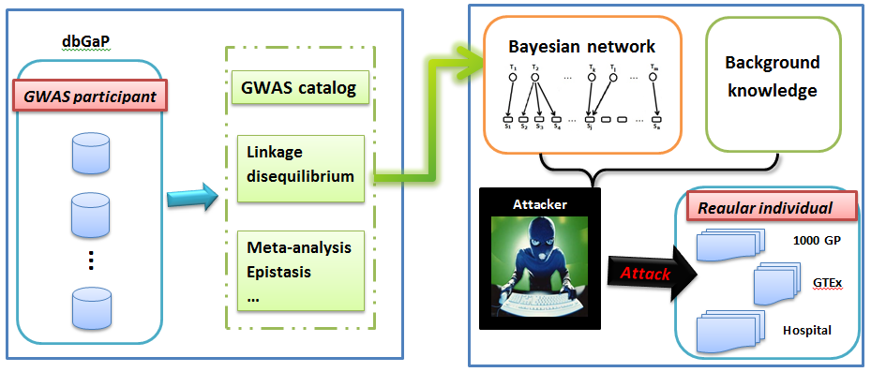
Preserving Genetic Privacy
“Using Aggregate Human Genome Data for Individual Identification”, Wang Y, Wu X, and Shi X, BIBM13
(Best Paper Award).

Slide 41

Genetic Privacy of HeLa Cells
A recent release of the whole genome sequence of HeLa cells, one of the most widely used yet controversial cell lines, has motivated significant debate on the privacy concern of Henrietta Lacks (the source of Hela cells) and her descendents from open access of her sequence.
Due to the privacy concern brought by the general public and scientific communities, the original publication was retracted and the sequence of HeLa cells was taken out from public domain.
The HeLa sequence is now under controlled access from dbGaP and the applications for access has to be reviewed by a committee composed of scientists and Lacks family members.

Slide 42
Other Genomics Data
Although genotype data is under controlled access such as in dbGaP, gene expression profiles and known statistics are usually open and unprotected.
A recent study reported that these expression data could be used to predict the individuals’ genotypes at particular loci.
Hence, the openly accessed gene expression and RNA sequencing data provides yet another potential source of privacy disclosure.
Eric E Schadt, Sangsoon Woo, and Ke Hao. Bayesian method to predict individual snp genotypes
from gene expression data. Nature genetics, 44(5):603–608, 2012.
Notes:
epigenomics

Slide 43
Personal Genome Project
Sharing data is critical to scientific progress, but has been hampered by traditional research practices.
The Personal Genome Project was founded in 2005 and is dedicated to creating public genome, health, and trait data: invite willing participants to publicly share their personal data for the greater good.

Slide 44
PGP Accident
Another accident of personal privacy is the recent exposure of the full names of PGP participants from filenames in the database.
The PGP, an open repository of human genomes and all related traits, allowed participants to upload 23andMe genotyping files to the participants’ public profile webpages. Many users simply used the default name convention which is the first and last names of the user, and thus made their genotypes explicitly identifiable.

Slide 45
Global Alliance (GA4GH)
The Global Alliance for Genomics and Health (Global Alliance) is an international coalition, dedicated to improving human health by maximizing the potential of genomic medicine through effective and responsible data sharing.
Since its formation in 2013, the Global Alliance for Genomics and Health is leading the way to enable genomic and clinical data sharing. The Alliance’s Working Groups are producing high-impact deliverables to ensure such responsible sharing is possible, such as developing a Framework for Data Sharing to guide governance and research and a Genomics API to allow for the interoperable exchange of data. The Working Groups are also catalyzing key collaborative projects that aim to share real-world data, such as Matchmaker Exchange, Beacon Project, and BRCA Challenge.
http://genomicsandhealth.org/
Notes:
Tute Genomics Donates 8.5 Billion Record Genetic Database to Google Genomics to Accelerate Genetic Discovery, Mar 13, 2015

Slide 46
Differential Privacy Preservation
Differential privacy is a paradigm of post-processing the output of queries such that the inclusion or exclusion of a single individual from the data set makes no statistical difference to the results found.
The applicability of enforcing differential privacy in genomic data has been recently studied where statistics (e.g., the allele frequencies of cases and controls, chi-square statistic and p-values) and logistic regression were explored on GWAS data.
Stephen E Fienberg, Aleksandra Slavkovic, and Caroline Uhler. Privacy preserving gwas data sharing. In Data Mining Workshops (ICDMW), 2011 IEEE 11th International Conference on, pages 628–635. IEEE, 2011.
Aaron Johnson and Vitaly Shmatikov. Privacy-preserving data exploration in genome-wide association studies. In Proceedings of the 19th ACM SIGKDD international conference on Knowledge discovery and data mining, pages 1079–1087. ACM, 2013.

Slide 47
Cryptographic Solutions
Cryptographic studies are often used for the task of out-sourcing computation on genetic information to third parties without revealing any genetic information to the service provider.
Homomorphic encryption: A user sends the encrypted version of his genomic data to the third party for interpretation. The interpretation party cannot read the plain genotypic values (because it does not have the key), but can execute the analytical algorithms on the encrypted genotypes directly.
Secure multiparty computation: Allows two or more entities, each of which has some private genetic data, to execute a computation on these private inputs without revealing the input to each other or disclosing it to a third party.

Slide 48
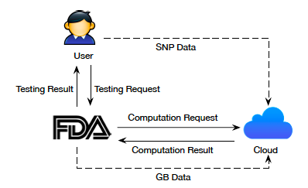
Secure Genetic Testing on Cloud
Han J, Li X-Y, and Shi X, "Secure Cloud-Delegated Genetic Testing for Personalized Medicine with
Genetic Biomarker Hiding", in submission.
Notes:
User’s sensitive information: genotypes
Genetic biomarker information

Slide 49
Summary and Future Work
Big data analytics, data integration, and bioinformatics become essential as we enter the era of personalized/precision medicine.
Promote open science, data sharing, yet addressing the concern of data privacy.

Slide 50


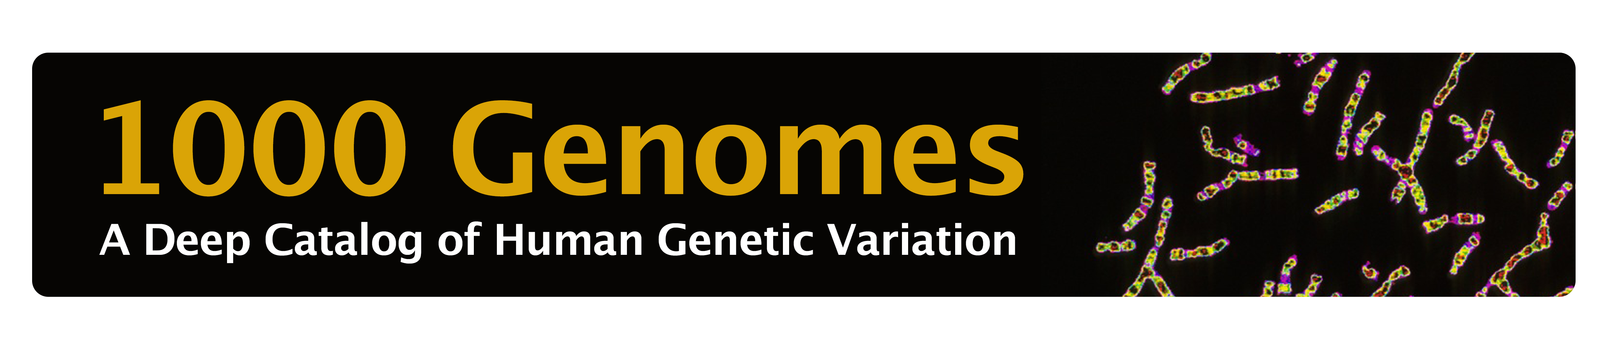
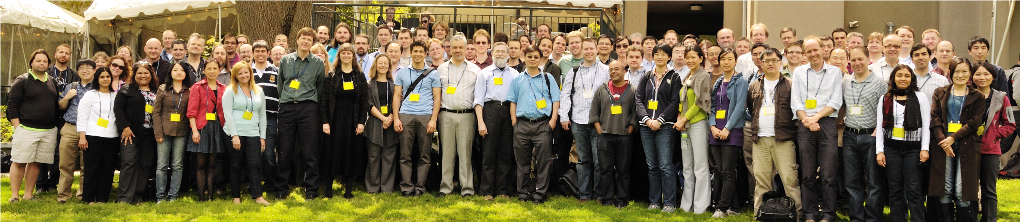
Acknowledgement
Xinghua Mindy Shi
Jia Wen
Andrew Quitadamo
Benika Hall
Lu Tian
Dahlia Shvets
Heena Desai
Sasan Najar
Xintao Wu (UArk)
Yue Wang (UNCC)
Xiang-Yang Li (IIT)
Junze Han (IIT)

Slide 51
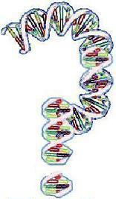
Thank You!

